Slide 1
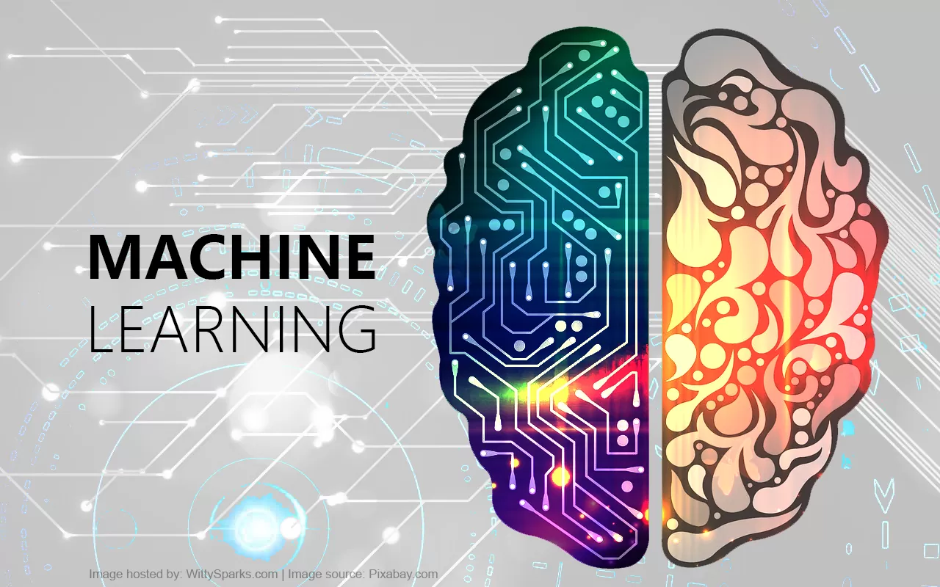
Decoding Success: Machine Learning-driven Forecasting and Sentiment Analysis for a Specific Amazon Product
Group Members : Gantyada Tejesh Kumar
Subham Kumar Sahoo
Shiba Narayan Dash
Pranabesh Mishra
SSI Pritam Biswal
Swapnil Nanda
Monali Sasamal
Rupali Pradhan
Soumya Ranjan Purohit
Pallishree Behera

Slide 2
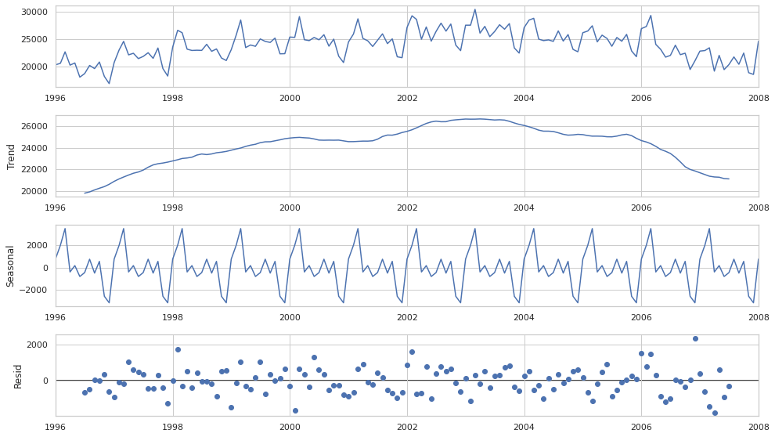
What is FORECASTING?
In machine learning, forecasting refers to the process of predicting future values or trends based on past data. It involves training a model on historical information and using that model to make predictions about future outcomes. Common applications include stock price prediction, weather forecasting, and sales projections. Time series models, such as ARIMA or LSTM, are often used for forecasting tasks.

Slide 3





Why FORECASTING?
Forecasting in machine learning is used to anticipate future trends, behaviors, or values based on historical data. It serves various purposes, including:
Decision Making:
Businesses use forecasting to make informed decisions, plan resources, and allocate budgets effectively.
Resource Planning: Forecasting assists in optimizing resource allocation, whether it's manpower, inventory, or financial resources, leading to improved efficiency.
Demand Prediction: Companies use forecasting to estimate future demand for products or services, enabling them to adjust production or supply chain strategies accordingly.
Risk Management:
Predicting future outcomes helps in identifying and mitigating potential risks, allowing for better risk management strategies.
Financial Planning: Forecasting is crucial in financial sectors for budgeting, investment planning, and assessing financial risks.
Optimizing Operations: Industries like transportation and logistics use forecasting to optimize routes, manage inventory, and improve overall operational efficiency.
Marketing Strategies: Predicting customer behaviour aids in tailoring marketing strategies, personalized recommendations, and enhancing customer satisfaction.
In essence, forecasting in ML empowers organizations to make proactive and informed decisions, adapt to changing circumstances, and achieve more efficient and effective operations.

Slide 4
The Importance of Forecasting in Business
Strategic Planning
Resource Allocation
Financial Management
Forecasting aids in strategic planning by providing crucial insights into potential risks, opportunities, and overall business performance.
It helps businesses allocate resources more effectively by predicting demand and optimizing inventory levels.
Accurate forecasting enhances financial management by enabling businesses to create realistic budgets and set achievable targets.

Slide 5

How it is done?
Forecasting in machine learning involves using historical data to make predictions about future values. There are various techniques and algorithms that can be employed for forecasting, depending on the nature of the data and the problem at hand. Here are some common approaches:
Time Series Analysis:
Time series data involves observations recorded at different points in time. Techniques such as autoregressive integrated moving average (ARIMA) or seasonal decomposition of time series (STL) are commonly used for time series forecasting.Long Short-Term Memory (LSTM) networks and other recurrent neural networks (RNNs) are also powerful tools for time series prediction, especially when dealing with complex patterns.
Regression Analysis:
Regression models can be used when there is a clear relationship between the input features and the target variable. Linear regression or polynomial regression are examples. Machine learning algorithms like Support Vector Machines (SVM), Random Forests, and Gradient Boosting can also be applied for regression-based forecasting.
Prophet:
Developed by Facebook, Prophet is a time series forecasting tool designed for datasets that exhibit strong seasonal patterns and multiple seasonality. It can handle missing data and outliers effectively.
Exponential Smoothing (ETS):
ETS models are a family of forecasting methods that incorporate exponential smoothing. This approach is suitable for time series data with trends and seasonality.

Slide 6
5. Deep Learning Models:
Neural networks, especially deep learning models like feedforward neural networks, recurrent neural networks (RNNs), and long short-term memory networks (LSTMs), can capture complex patterns in data and are effective for forecasting tasks.
6. Ensemble Methods:
Techniques that combine predictions from multiple models, such as bagging (Bootstrap Aggregating) or boosting, can improve forecasting accuracy. Random Forest and Gradient Boosting are popular ensemble methods.
7. ARIMA-X:
ARIMA models can be extended to include exogenous variables (ARIMA-X), which are additional features that can improve forecasting accuracy by incorporating external factors.
8. Hybrid Models:
Combining different forecasting methods can often lead to improved accuracy. For instance, combining a traditional time series model with a machine learning model might leverage the strengths of both approaches.
The choice of a specific forecasting method depends on the characteristics of the data, the underlying patterns, and the goals of the forecasting task. It's common to split the dataset into training and testing sets, with the training set used to train the model and the testing set used to evaluate its performance on unseen data. Additionally, hyperparameter tuning and optimization are essential for achieving the best forecasting results. Here we have used SARIMA model.

Slide 7




Benefits of Machine Learning-driven Forecasting
Enhanced Accuracy
Machine learning models can analyze vast amounts of data to identify complex patterns, leading to more accurate forecasts.
Real-Time Insights
It provides businesses with timely information, allowing them to respond quickly to market changes and emerging trends.
Adaptability
These systems can adapt to changing conditions and automatically improve their performance over time.

Slide 8

What is Sentiment Analysis ?
Sentiment Analysis is the process of computationally identifying and categorizing opinions expressed in a piece of text, especially in order to determine whether the writer’s attitude towards a particular topic, product, etc. is positive, negative or neutral. In simple words, it is the field that tries to give machines and computer software the ability to understand the emotions of the user. By decoding customer sentiments, businesses can gain a deeper understanding of their products' performance and make better decisions about their future strategies.

Slide 9


What is Lexicon and Sentiment Lexicons?
Vocabulary Or Dictionary or in simple words complete set of meaningful units in a language.
A sentiment lexicon is a database of lexical units for a language along with their sentiment orientations.
Let us look at some examples below :
Positive
Negative
Achieve
Better
Creative
Innovative
Efficient
Adverse
Against
Concern
Default
Damage

Slide 10
Why to do Sentiment Analysis
Some Reasons why organizations do Sentiment Analysis :
Understand customer satisfaction: Analyze customer reviews, feedback, and social media mentions to see if customers are happy or frustrated with your product, service, or brand. To find out if their product review positive or negative. To check if the market sentiment is positive or negative.
Brand Monitoring : Monitoring sentiment on social media and other platforms helps organization track and manage their brand reputation.
Improve product development: Analyze product reviews and feedback to understand what features resonate with customers and guide future product iterations.
New Product? What do people think about their new product? How is the consumer confidence in their new product or service?
Customer Service Optimization : It aids in evaluating the effectiveness of customer service interactions. By understanding customer
sentiments, companies can identify areas for improvement and enhance the overall customer service experience.
Product Development and Improvement : Analyzing sentiments in customers feedback provides insights into specific features, aspects or issues related to the products. This information helps the companies in product development.

Slide 11

Understanding Sentiment Analysis
1
Data Analysis
2
Natural Language Processing
Sentiment analysis involves examining large sets of data to identify and categorize opinions and emotions expressed in them.
The process uses Natural Language Processing (NLP) algorithms to decipher the meaning and sentiments behind customer feedback.
3
Machine Learning
It often utilizes machine learning techniques to continuously improve accuracy and understand the subtleties of human language.

Slide 12
Importance of Sentiment Analysis for Amazon Products
75%
30+
Customer Insights
Product Reviews
Gain a comprehensive understanding of customer sentiments, which can help improve product development and marketing strategies.
Analyze a large volume of product reviews efficiently, providing a holistic view of customer opinions and satisfaction.

Slide 13
Methodology: How Sentiment Analysis Works
We have imported a variety of Python libraries that are commonly used for data manipulation, natural language
processing (NLP), visualization, and machine learning tasks.
Each of these libraries serves a specific purpose.
1. re
2. numpy as np
3. pandas as pd
4. nltk
5. seaborn as sns
6. plotly.express as px
7. matplotlib.pyplot as plt
8. WordCloud
9. plotly.graph_objects as go
10. sklearn

Slide 14
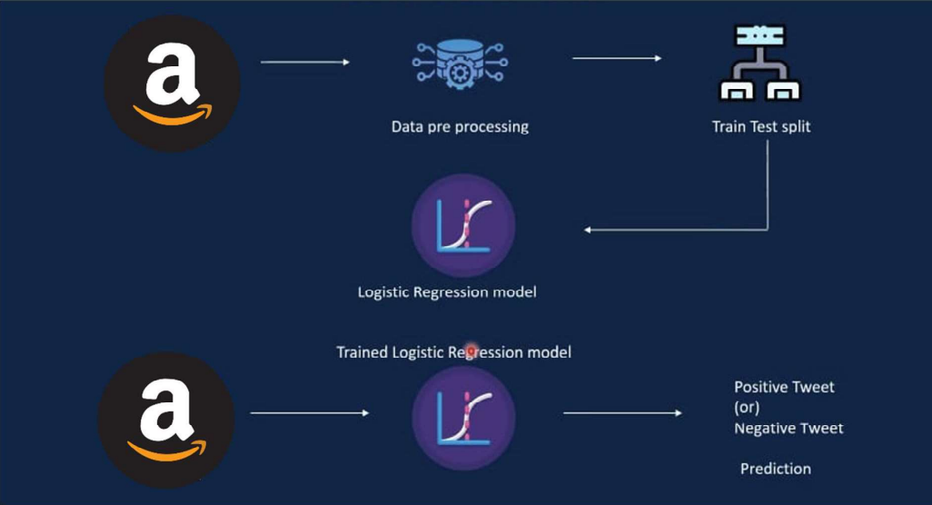
Case Study: Sentiment Analysis for the Amazon Product - Kindle
1. Data collection - Large sets of data is collected to identify and categorize opinions and emotion expressed in them.
2. Data Processing – It is the technique of preparing(cleaning and organizing ) the raw data to make it suitable for a building and training
Machine Learning models.
3. Data splited into 2 parts – i) Train Data ii) Test Data
Train data : Training data refers to a set of labeled examples
used to train a machine learning model.The training data typically
consists of a collection of text samples along with their corresponding
sentiment labels, indicating whether the text expresses a positive,
negative or neutral sentiment.
Test data : test data refers to a separate set of examples that are not used
during the training phase but are reserved to evaluate the performance of
a trained sentiment analysis model.
4. Creating a model using logistic regression
5. New Data - This is additional, unlabeled data that the model encounters
after training. It represents the real-world text that the model needs to
analyze sentiment for in practical applications. Sentiment analysis models
are designed to generalize well to new and unseen examples, making them
applicable to a variety of situations.

Slide 15
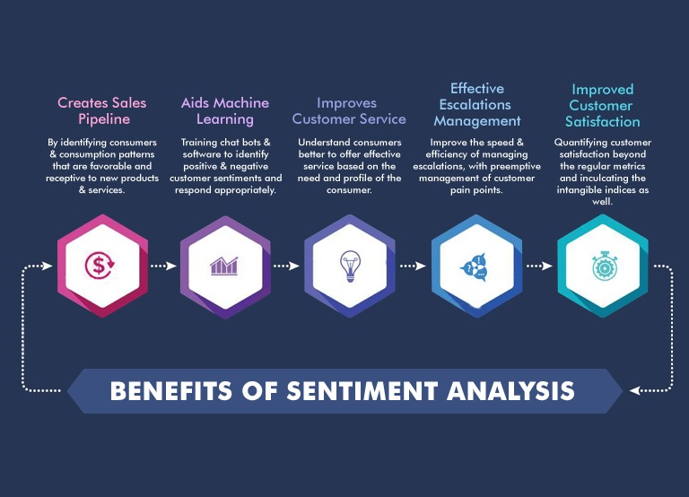

Slide 16



Results and Insights from the Sentiment Analysis
Positive Sentiment
Negative Sentiment
Identification of positive sentiments expressed, helping understand product strengths and popularity.
Insights into areas for improvement, based on negative feedback and customer dissatisfaction.
Acclaim
Brilliant
Convenient
Durable
Enjoyable
Ethical
Dishonest
Failure
Gruesome
Hazardous
Imbalance
Lacking

Slide 17

Result
Sentiment analysis provides your business with a way to quantify these emotions to discover the overall answer polarity and insights into your customer feedback. Because customer sentiment is provided in the person’s voice, and not based on a set response or keywords, you need a way for your computers to understand it. Sentiment analysis programs have a standardized approach that gets the same results regardless of the person running the process. It’s difficult to achieve this manually, but computer-aided methods make it possible.
Training Data Accuracy
Testing Data Accuracy
78.72 %
76.54 %

Slide 18

THANK YOU

